Slide 1
WebROVER for Restaurants
Revolutionizing Restaurant Service with Robotics and Web Technology
Akhula Akhil Vignesh-CB.SC.U4AIE23303
Prisha Gupta- CB.SC.U4AIE23331
Vedant Maheshwari- CB.SC.U4AIE23346
Naksh Singh- CB.SC.U4AIE23361

Slide 2

OBJECTIVE
The objective of this project is to enhance restaurant service by automating food delivery through a robot. The robot will navigate autonomously to deliver food to customer-selected tables, improving both efficiency and customer satisfaction. Restaurant manager will interact with a web interface to choose table number. The robot, equipped with a preloaded map of the restaurant, will use this input to navigate accurately to the designated table. This system aims to reduce the dependency on human waitstaff, minimize service delays, and streamline operations, ultimately providing a more efficient and consistent dining experience.

Slide 3
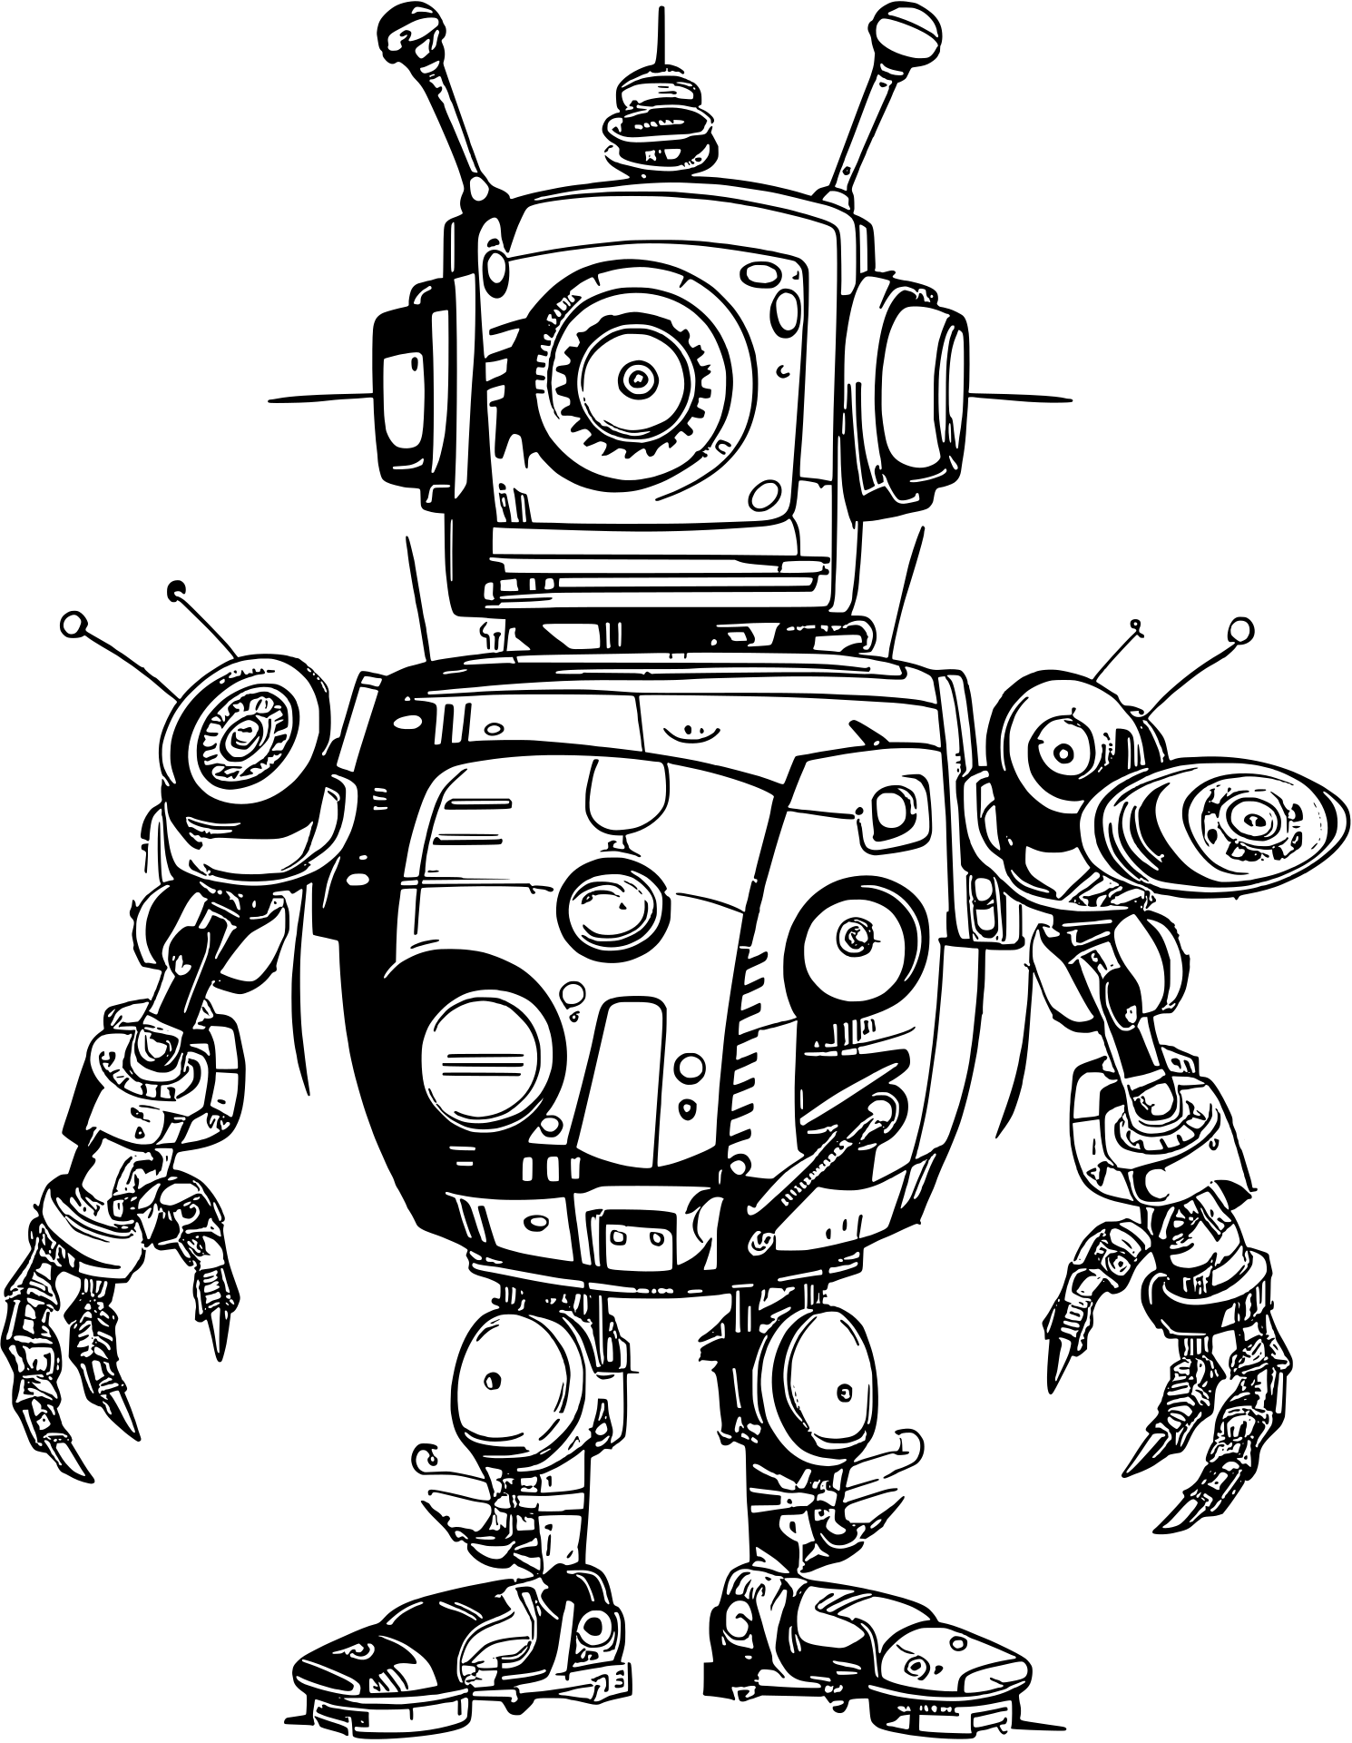
LITERATURE REVIEW

Slide 4

ASSISTIVE Delivery Robot for Postal Services
This paper presents a robotic system designed to assist postal workers in urban environments where GPS signals are unreliable. Using a 3D point-cloud-based localization system and perception-driven path planning, the robot autonomously navigates complex areas or follows a postal worker. It is controlled via a mobile device, reducing workload and improving efficiency in package delivery.
CHALLENGES:
Designed for outdoor environments, not restaurant spaces.
Relies on 3D point-cloud mapping, which may be computationally expensive for real-time operations in indoor settings.
Uses mobile control, but lacks integration with web-based ordering systems.
D. Lee, G. Kang, B. Kim and D. H. Shim, "Assistive Delivery Robot Application for Real-World Postal Services," in IEEE Access, vol. 9, pp. 141981-141998, 2021, doi: 10.1109/ACCESS.2021.3120618.

Slide 5
FOOD DELIVERY AUTOMATION IN RESTAURANTS USING COLLABORATIVE ROBOTICS
This paper explores a multi-robot collaborative system for automating food delivery in restaurants. A centralized control station assigns robots based on energy, distance, and efficiency heuristics. The robots navigate using modified A* path planning and communicate with a web-based order management system, enhancing service speed and reducing labor costs.
CHALLENGES:
Uses centralized control, which can create a single point of failure.
Relies on Bluetooth communication, which may have limited range and interference issues in real-world restaurant setups.
A. Antony and P. Sivraj, "Food Delivery Automation in Restaurants Using Collaborative Robotics," 2018 International Conference on Inventive Research in Computing Applications (ICIRCA), Coimbatore, India, 2018, pp. 111-117, doi: 10.1109/ICIRCA.2018.8597280.

Slide 6

DESIGN OF A LOW-COST INDOOR NAVIGATION SYSTEM FOR FOOD DELIVERY ROBOT BASED ON MULTI-SENSOR INFORMATION FUSION
This study proposes a multi-sensor fusion system for meal delivery robots, integrating ultra-wideband (UWB) positioning, odometry, and low-cost gyroscopes. Unlike traditional magnetic navigation, this approach allows for flexible and cost-effective indoor navigation with a positioning error of around 30 cm, making it viable for restaurant automation without requiring structural modifications.
CHALLENGES:
Uses magnetic navigation, requiring physical path adjustments.
Positioning error (~30 cm) could be problematic in tight restaurant spaces.
Limited flexibility in adapting to dynamic obstacles like moving customers.
Sun, Y.; Guan, L.; Chang, Z.; Li, C.; Gao, Y. Design of a Low-Cost Indoor Navigation System for Food Delivery Robot Based on Multi-Sensor Information Fusion. Sensors 2019, 19, 4980.

Slide 7
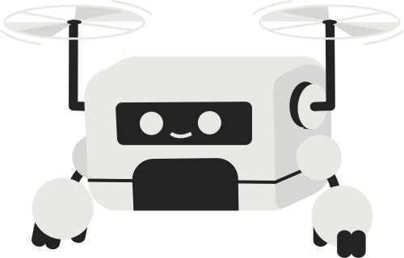
DEVELOPMENT OF AN INDOOR DELIVERY MOBILE ROBOT FOR A MULTI-FLOOR ENVIRONMENT
This paper presents an autonomous delivery robot designed for multi-floor navigation in indoor environments like offices, hospitals, and hotels. The system integrates map management, localization, path planning, perception, and task planning to enable smooth movement, including elevator usage. A 3D route-planning approach combined with a multi-floor navigation map allows the robot to transition between floors seamlessly. A month-long field test demonstrated the system’s robustness, making it a viable solution for last-mile indoor delivery without human intervention.
CHALLENGES:
Task planning needs refinement for real-world restaurant environments.
T. Kim, G. Kang, D. Lee and D. H. Shim, "Development of an Indoor Delivery Mobile Robot for a Multi-Floor Environment," in IEEE Access, vol. 12, pp. 45202-45215, 2024, doi: 10.1109/ACCESS.2024.3381489.

Slide 8
UNDERSTANDING THE ROBOTIC RESTAURANT EXPERIENCE: A MULTIPLE CASE STUDY
Investigates the role of service robots in restaurants and evaluates their ability to replace human staff.
Found that robots require human assistance for complex tasks and are not fully autonomous.
Highlights that robots perform well in repetitive tasks but struggle with dynamic decision-making.
Focused on customer experiences and how robots influence satisfaction and service quality.
CHALLENGES:
Lack of autonomy: Robots cannot handle unexpected situations without human intervention.
Customer acceptance: Some customers feel uncomfortable interacting with robots instead of humans.
Maintenance issues: Frequent technical malfunctions requiring regular supervision.
Emotional connection: Inability to replicate the warmth and personal touch provided by human servers.
Seyitoğlu, F. and Ivanov, S. (2022), "Understanding the robotic restaurant experience: a multiple case study", Journal of Tourism Futures, Vol. 8 No. 1, pp. 55-72. M. Waqas, Z. Ali, M. Waqas and A. Zulafqar, "Development of Localization-Based Waiter Robot Using RP-LIDAR," 2022 16th International Conference on Open Source Systems and Technologies (ICOSST), Lahore, Pakistan, 2022, pp. 1-6, doi: 10.1109/ICOSST57195.2022.10016804.

Slide 9
ITERATIVE ROBOT WAITER ALGORITHM DESIGN: COCKTAIL-PARTY SERVICE EXPECTATIONS AND SOCIAL FACTORS
The study evaluates robot waiter algorithms and service parameters in a simulated cocktail event, focusing on variables like "hunger level," "relationship to each other," and robot delivery algorithms (lead, follow, ambient).
The results indicate a positive correlation between food-taking behavior and either human or robot initiative, with the robot that initiates being the most noticeable
CHALLENGES:
Human Interaction Dynamics
People sometimes forget or delay responding to robots, indicating challenges in maintaining engagement during interactions.
Ambient robot motion is often unnoticed by participants, highlighting difficulties in capturing attention without explicit cues
Reliance on Sparsity
Errors such as delivering food ordered by one person to another underscore the importance of accurate service delivery in human-robot interactions.
H. Knight, D. Flynn, T. M. Oo and J. Hansen, "Iterative Robot Waiter Algorithm Design: Cocktail-Party Service Expectations and Social Factors," 2024 19th ACM/IEEE International Conference on Human-Robot Interaction (HRI), Boulder, CO, USA, 2024, pp. 394-402.

Slide 10
DEVELOPMENT OF LOCALIZATION-BASED WAITER ROBOT USING RP-LIDAR
This paper explores the integration of RP-LIDAR for waiter robots, using laser beams to measure range and map the environment in Rviz.
The robot employs ROS Adaptive Monte-Carlo Localization (AMCL) within the ROS Melodic framework, enabling accurate positioning and path planning for efficient navigation to tables
CHALLENGES:
Data Association
The paper does not explicitly address the complexities of data association, which can be a challenge in dynamic environments where the robot must distinguish between static and moving objects.
Sensor accuracy
The effectiveness of the RP-LIDAR-based system heavily relies on the accuracy of the sensor data. Any inaccuracies in the LIDAR readings could potentially lead to errors in localization and navigation.
M. Waqas, Z. Ali, M. Waqas and A. Zulafqar, "Development of Localization-Based Waiter Robot Using RP-LIDAR," 2022 16th International Conference on Open Source Systems and Technologies (ICOSST), Lahore, Pakistan, 2022, pp. 1-6, doi: 10.1109/ICOSST57195.2022.10016804.

Slide 11
NON-CONTACT SERVICE ROBOT DEVELOPMENT IN FAST-FOOD RESTAURANTS
Focuses on developing a non-contact service robot for fast-food environments.
Utilizes 3D point cloud mapping combined with 2D occupancy grid maps for better environmental adaptability.
Implements an adaptive motion controller for smooth navigation in narrow aisles.
The robot was tested in real restaurant settings, with feedback collected on availability, usability, and satisfaction.
CHALLENGES:
Navigation in crowded spaces: Difficulty in maneuvering when many obstacles (like customers) are present.
Limited adaptability: Challenges in dynamically changing environments (e.g., rearranged tables).
Sensor limitations: Issues with accurate obstacle detection in low-light conditions.
Human-robot interaction: Difficulty in effectively communicating with customers without human-like gestures.
TY - JOUR,AU - Chen, Chin,AU - Lin, Chia AU - Lai, Chun PY - 2022/01/01 SP - 31466 EP - 31479 T1 - Non-Contact Service Robot Development in Fast-Food Restaurants VL - 10 DO - 10.1109/ACCESS.2022.3155661 JO - IEEE Access

Slide 12
SQUARE ROOT SAM
SLAM or Extended Kalman filter (EKF) - computationally expensive
SRIS: factorize the information matrix -> square root using Cholesky or QR factorization. This provides: faster computations, exact solutions, handling of non-linearity
CHALLENGES:
Computational Complexity Growth
Full trajectory smoothing causes computational complexity to grow without bound over time.
Covariance Recovery Cost
Expensive to recover the covariance matrix from the square root information matrix.
Dellaert F, Kaess M. Square Root SAM: Simultaneous Localization and Mapping via Square Root
Information Smoothing. The International Journal of Robotics Research. 2006;25(12):1181-1203. doi:10.1177/0278364906072768

Slide 13
ISAM: INCREMENTAL SMOOTHING AND MAPPING
It uses an incremental approach to update the square root information matrix.
It recalculates only the matrix entries that actually change
CHALLENGES:
Data Association
It does not delve deeply into the complexities of automatic data association, especially in scenarios with large loops in the trajectory.
Reliance on Sparsity
While the paper provides theoretical bounds on the fill-in for certain environments, the sparsity may not hold in all real-world scenarios, leading to performance degradation.
ISAM: Incremental Smoothing and Mapping. (2008, December 1). IEEE Journals & Magazine | IEEE Xplore. https://ieeexplore.ieee.org/abstract/document/4682731

Slide 14
RESEARCH GAP
Current robotic systems in restaurants face challenges in dynamic navigation, real-time adaptability, obstacle avoidance and user-friendly integration. Most solutions rely on centralized control or static path planning, which can fail in dynamic environments with moving obstacles like customers or staff.
Key Gaps:
Dynamic Navigation and Adaptability: Existing systems struggle with real-time navigation and obstacle avoidance, especially in the unpredictable, dynamic restaurant environment.
User Interface Usability: Current solutions either lack intuitive interfaces for restaurant staff or are constrained by mobile device-based control, reducing ease of use and operational efficiency.
Task Flexibility: Existing robots are often tied to rigid control systems or navigation maps, which may not adapt well to unexpected changes in the restaurant layout or customer movement.

Slide 15

PROPOSED METHOD
How It Works:
This project aims to develop an autonomous food delivery robot for restaurants, integrating Simultaneous Localization and Mapping (SLAM), autonomous navigation, and a web-based control interface.
The restaurant manager will be equipped with a webpage indicating table numbers. Upon pressing the table number robot will navigate to its required position.
The robot will use its preloaded map of the restaurant to identify the table's location.
The robot will navigate autonomously, avoiding obstacles.
Food placed on the tray attached to the robot will be delivered to the selected table.

Slide 16
PROPOSED METHOD
Core Features:
Efficient Navigation: Uses SLAM (Simultaneous Localization and Mapping) and path planning for accurate delivery.
User-Friendly Web Interface: Simple table selection for non-technical users.
Autonomous Operation: No need for human intervention in routine food delivery.
Scalability: Can be adapted for larger restaurant setups with multiple robots.

Slide 17
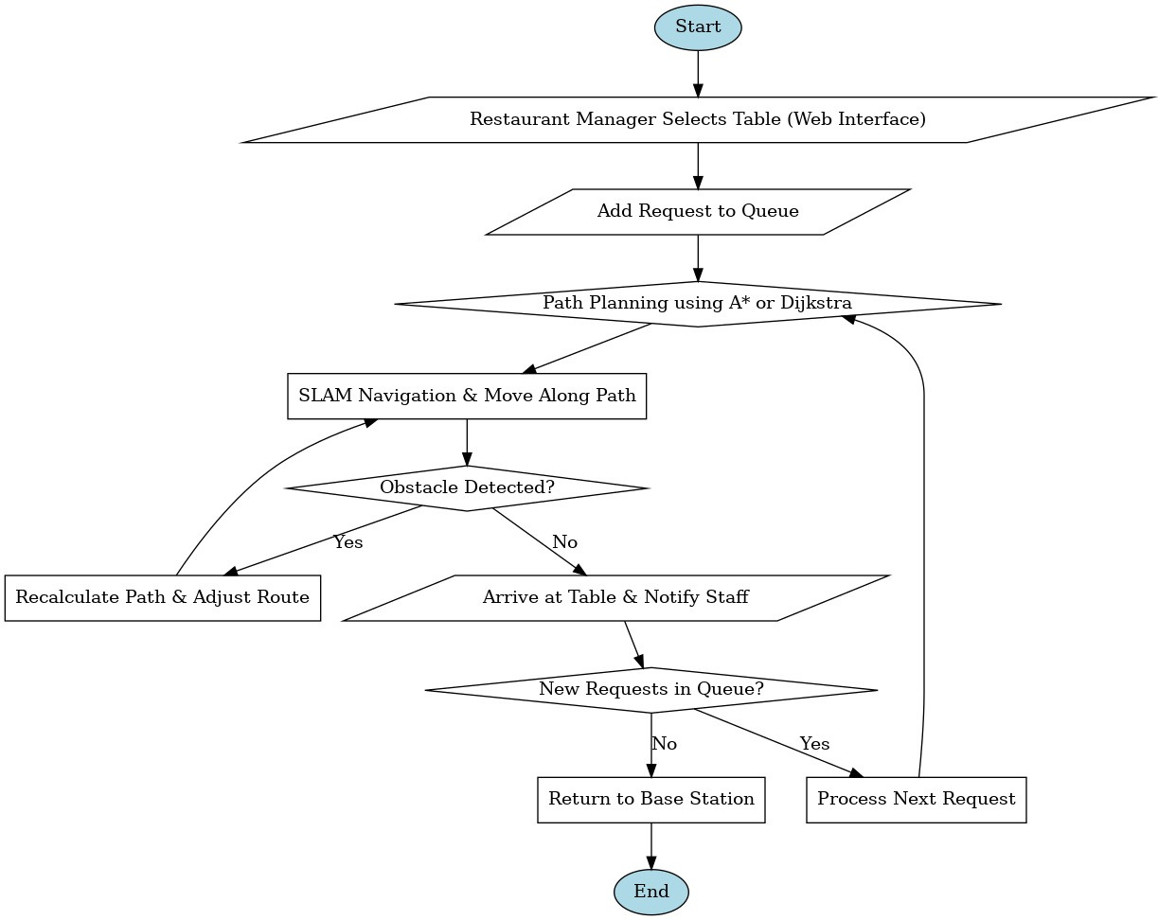
BLOCK DIAGRAM

Slide 18
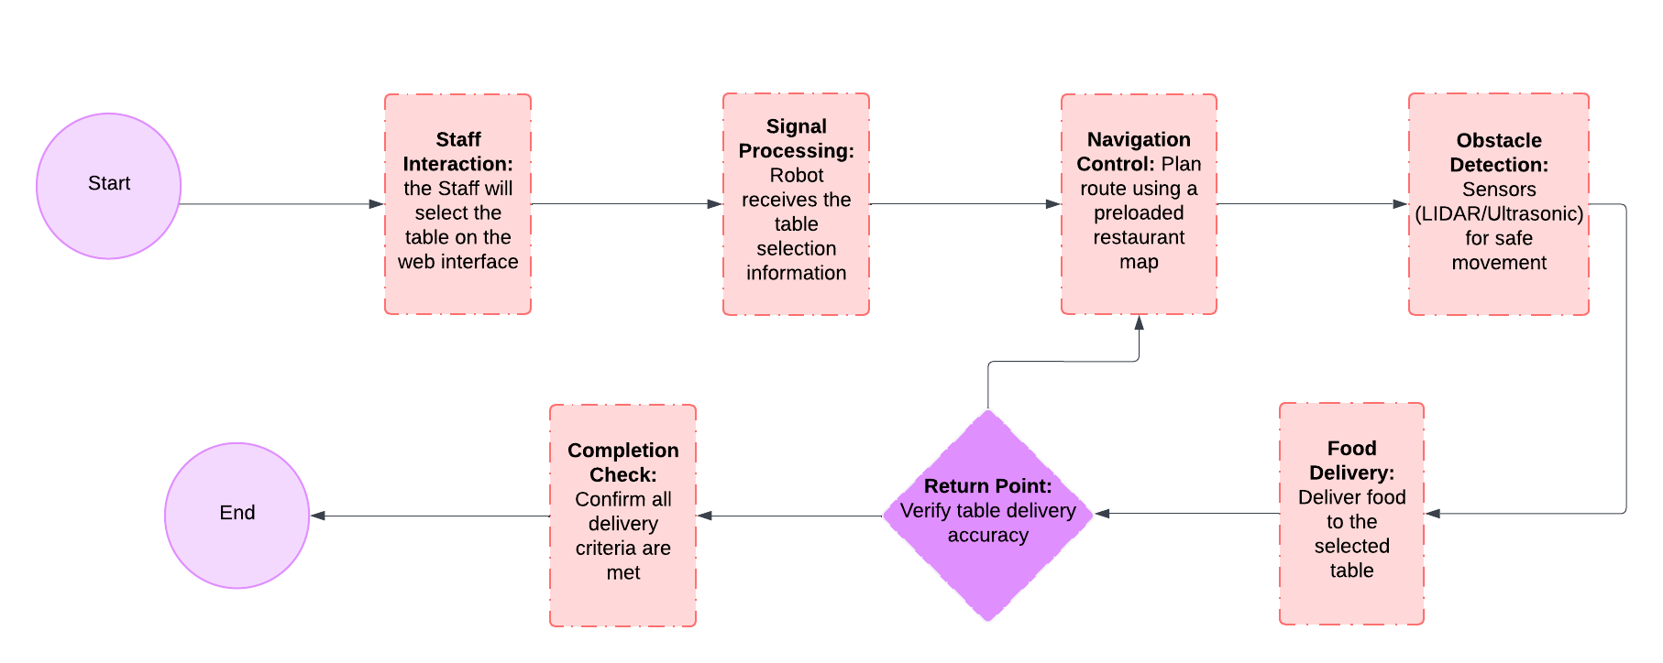
Block Diagram

Slide 19
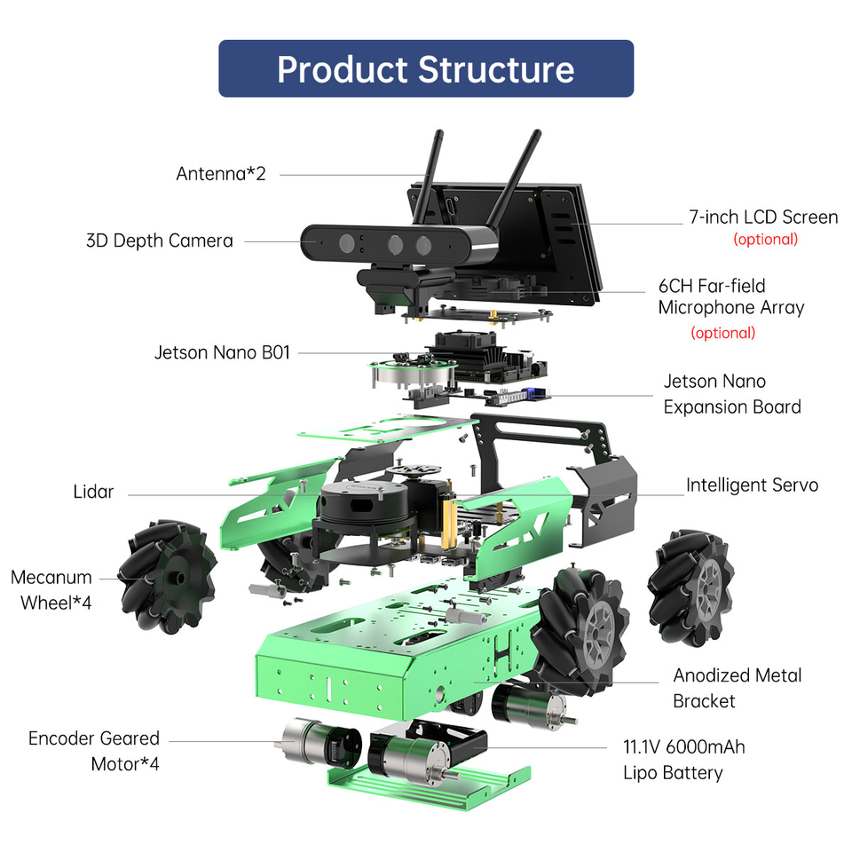
HARDWARE REQUIREMENTS

Slide 20
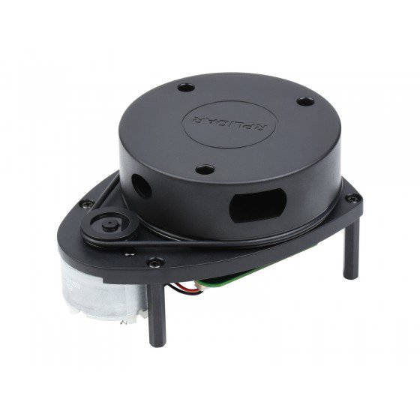
HARDWARE REQUIREMENTS
Navigation & Mapping Sensors
LiDAR Sensor (RPLIDAR A1/A2 or YDLIDAR)
Essential for 2D SLAM, accurate mapping.
Wheel Encoders (Integrated with JetAuto)
Provides odometry data for accurate localization.
Why Not GPS? GPS is inaccurate indoors

Slide 21
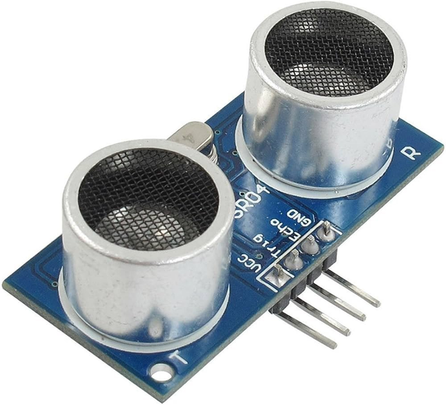
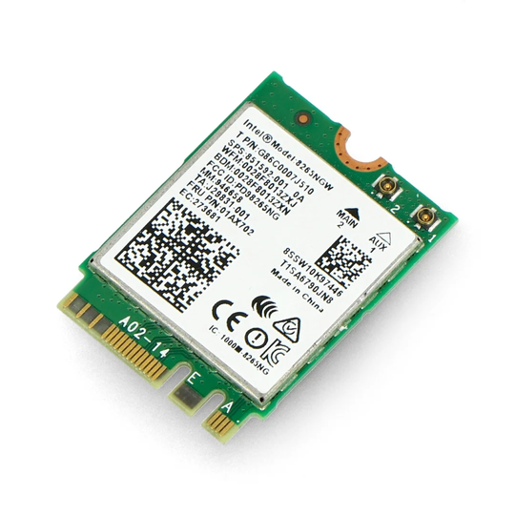
HARDWARE REQUIREMENTS
Obstacle Detection & Power
Ultrasonic Sensors (Optional, for low obstacles)
Detects small objects like bags, feet.
Battery Pack (JetAuto specs).
Communication
Wi-Fi Module (Built-in with Jetson Nano)
Connects robot to restaurant’s network.

Slide 22


SOFTWARE REQUIREMENTS
Operating System & ROS
Ubuntu 20.04
Stable, lightweight, and ROS-compatible.
ROS Noetic
Long-term support and well-documented.

Slide 23

SOFTWARE REQUIREMENTS
Web Interface & Communication
ROSBridge Suite
Enables real-time ROS-WebSocket communication.
Frontend (React.js / HTML, CSS, JavaScript)
Builds an intuitive web interface.

Slide 24
SOFTWARE REQUIREMENTS
SLAM & Navigation
GMapping (2D SLAM)
Lightweight, efficient, and perfect for indoor mapping with LiDAR[Light Detection and Ranging].
AMCL (Adaptive Monte Carlo Localization)
Precise localization using particle filters.
move_base (Navigation Stack)
Handles path planning, obstacle avoidance.

Slide 25
SOFTWARE REQUIREMENTS
Visualization & Development Tools
RViz
Visualizes robot position, maps, navigation paths.
Python
Primary language for ROS scripting.

Slide 26
MATHEMATICAL ASPECT
Using 2D SLAM with GMapping, which falls under the broader category of Graph-Based SLAM.
In Graph-Based SLAM, the robot builds a map by creating nodes (representing its positions) and edges (representing the movement between these positions).
Using Graph Algorithms such as Djikstra/A* for shortest distance path planning.
switching from Queue based serving to nearest table serving

Slide 27
PHASES OF PROJECT - TIMELINE
Phase 2: Web Interface Development
Phase 4: Robot Construction & testing
01/02/25
10/03/25
15/02/25
30/03/25
Phase 1: Research and Planning
Phase 3: Integration of navigation and mapping

Slide 28

THANK YOU!!

